Slide 1

Cn3D
“See in 3D”
Austin Lux

Slide 2
About Cn3D
Helper application for viewing 3D structures from Entrez
Correlates structure and sequence information
Structure-structure alignments
OpenGL (Graphical API)
Helper and standalone applications

Slide 3
Getting Started with Cn3D
Windows and Mac*
Download from NCBI and install
*32bit application, not compatible with MacOS Catalina or Big Sur

Slide 4
Individual Structures (MMDB)
Does not read Protein Data Bank (PDB) file format
NCBI’s proprietary Molecular Modeling Database (MMDB)
Validation and Error Correction
Allows 3D structural alignment
COVID or human PTEN protein

Slide 5
Method 1: Directly from Entrez
Step 1: Navigate to NCBI’s Entrez
Step 2: Select ”Structure”
Step 3: Search the protein of interest
Step 4: Open and enjoy

Slide 6
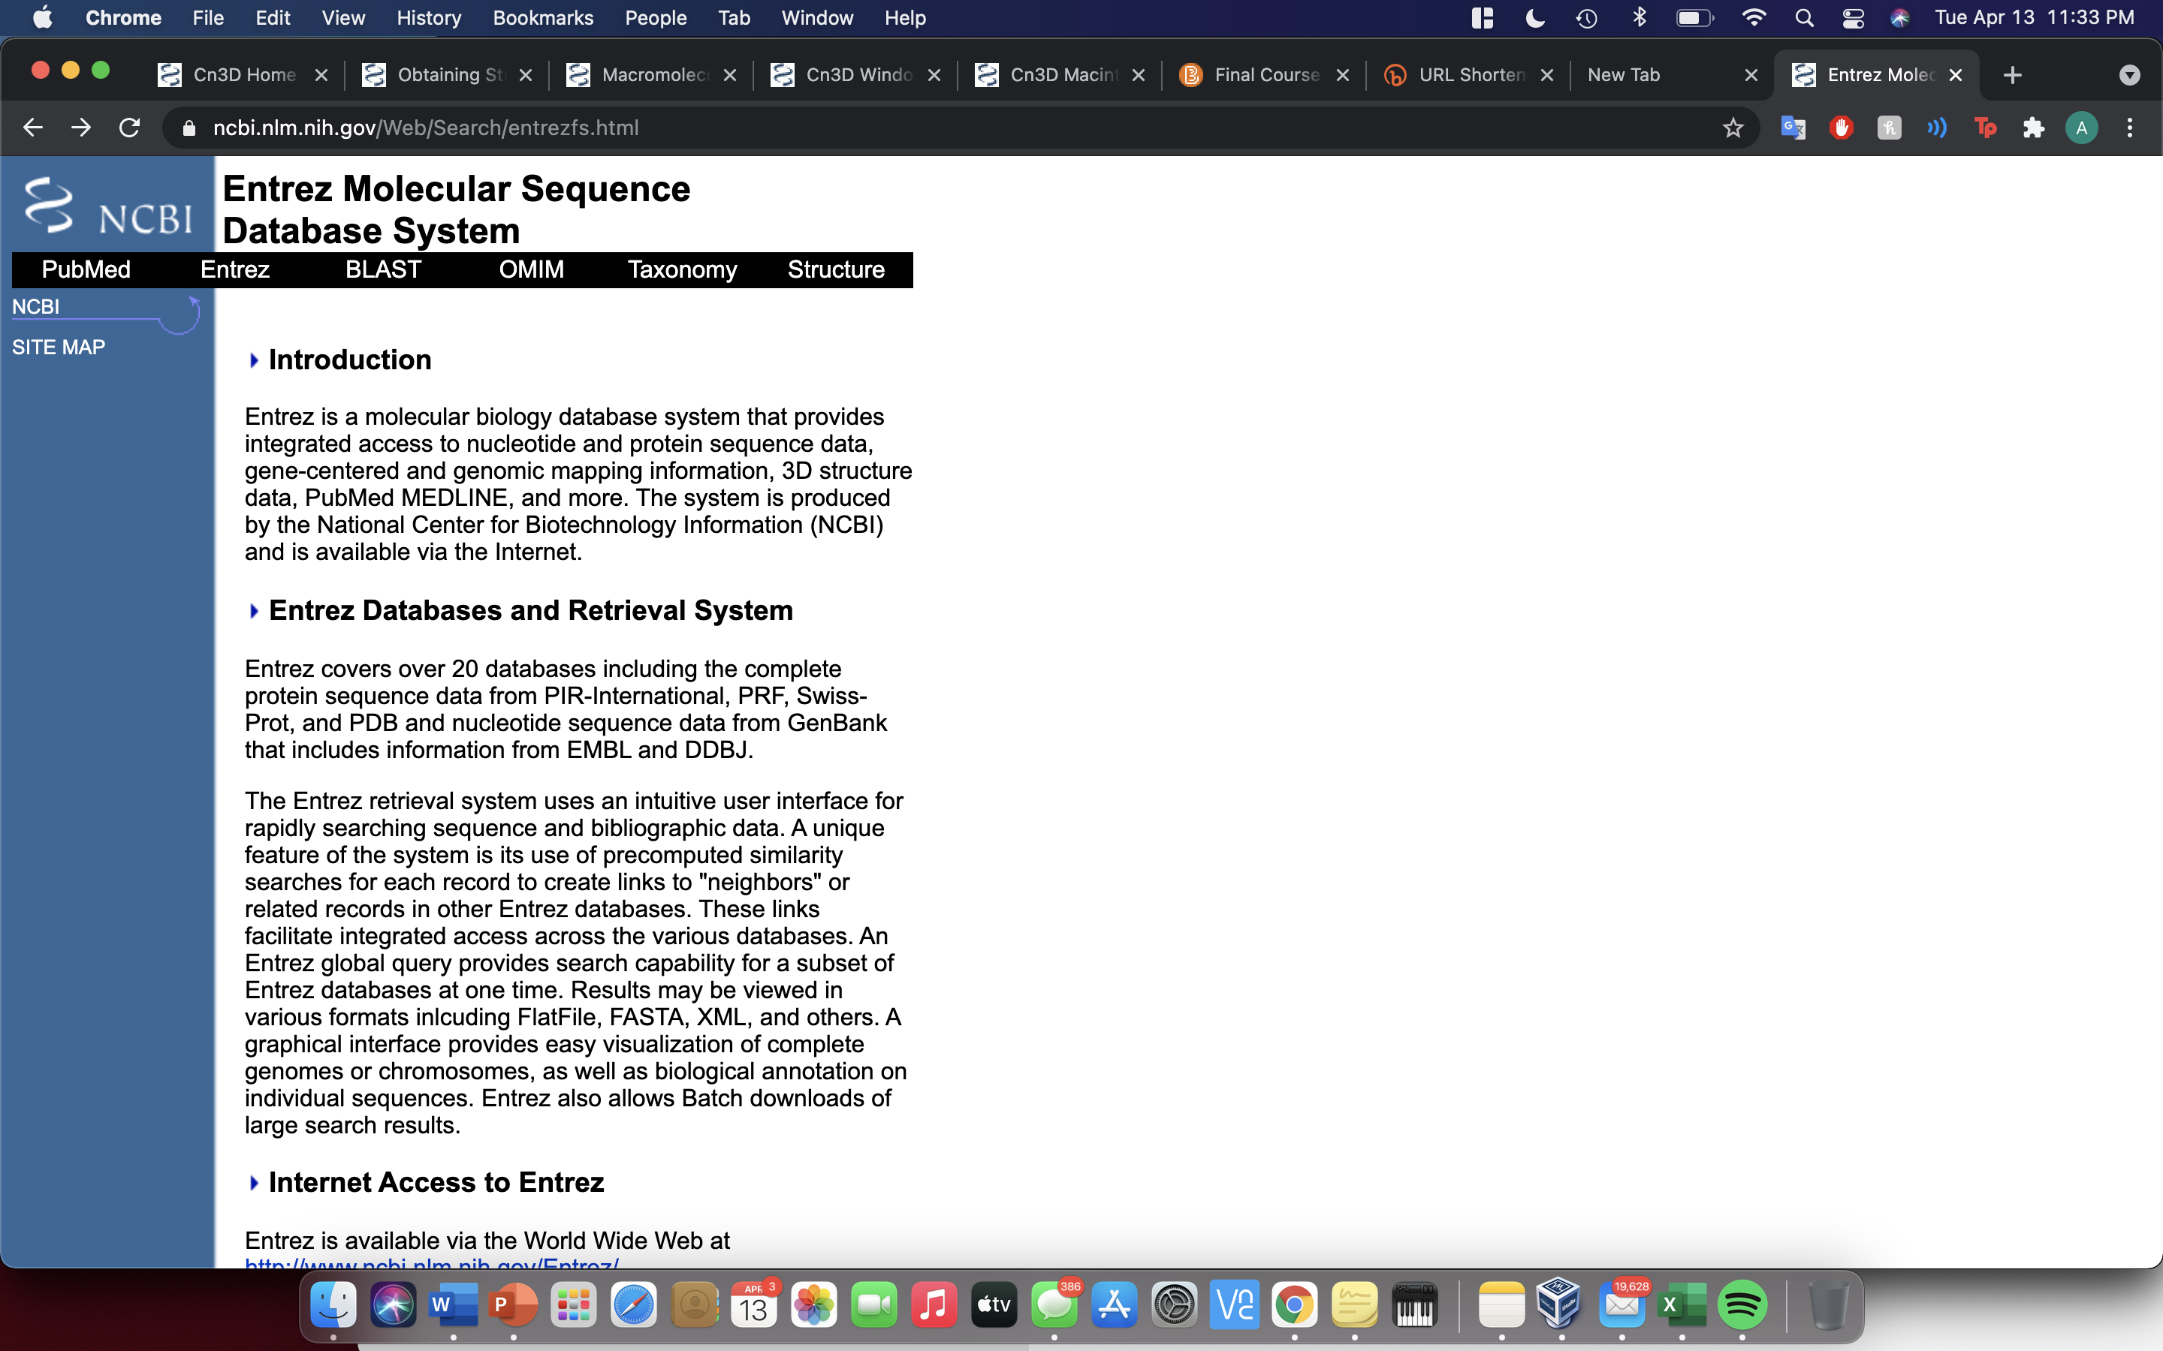

Slide 7
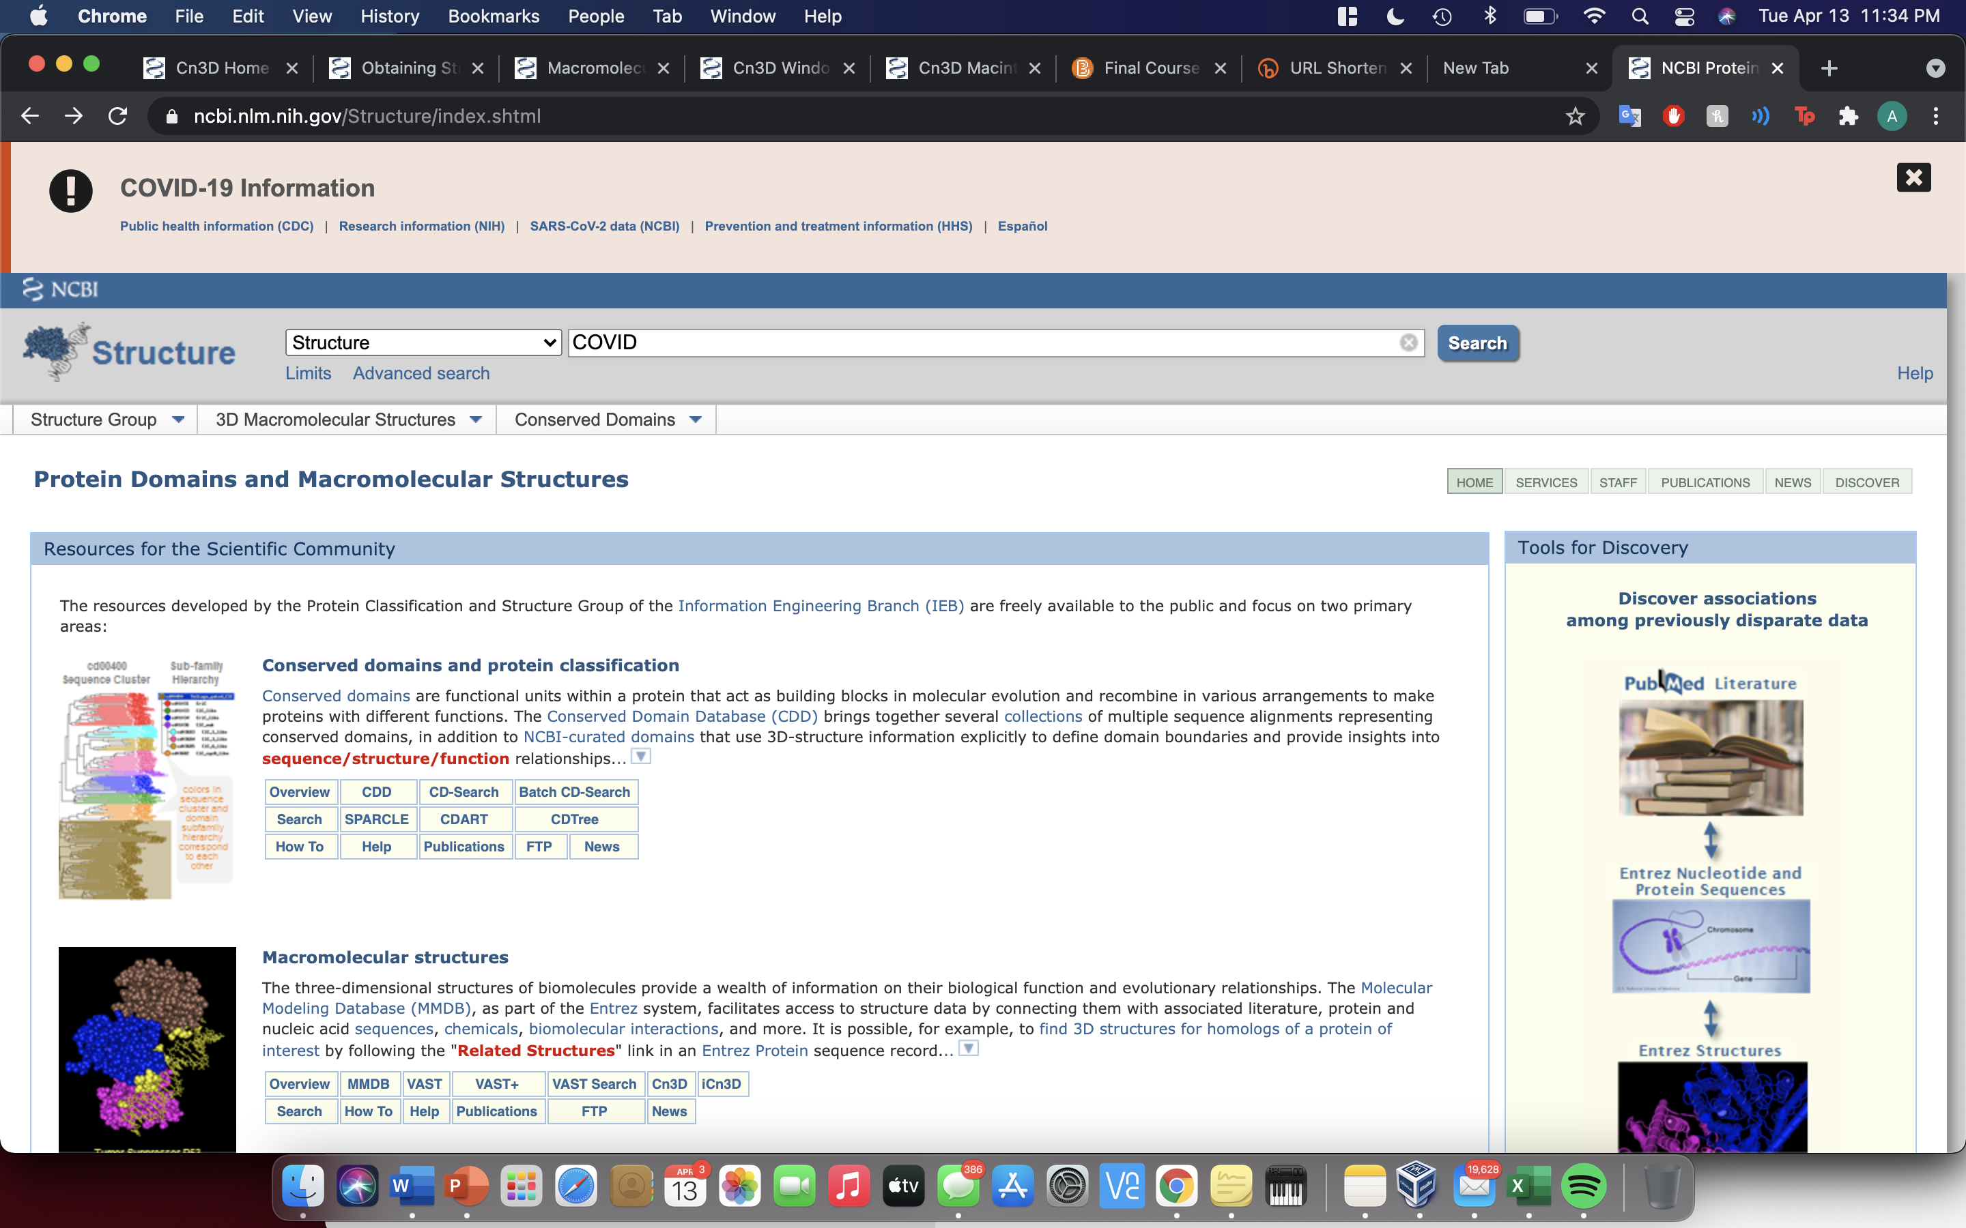

Slide 8
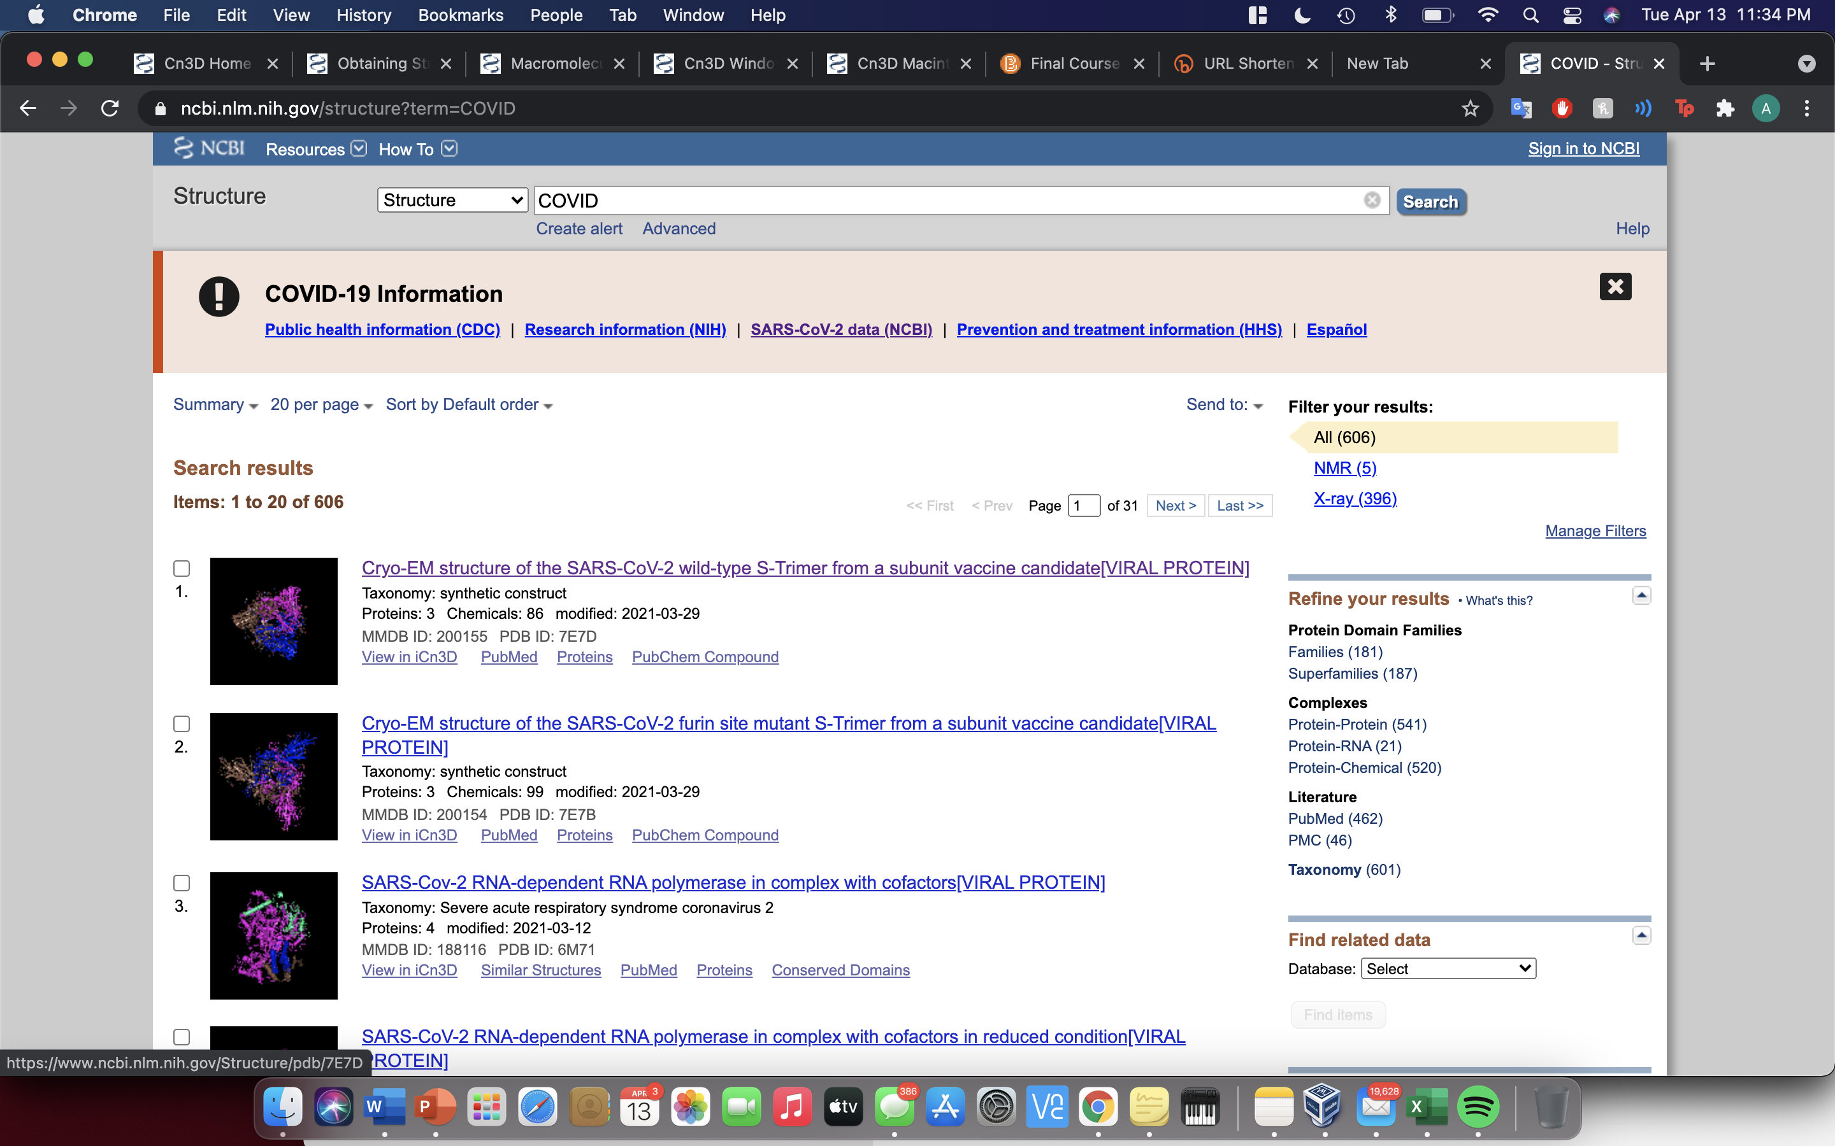

Slide 9
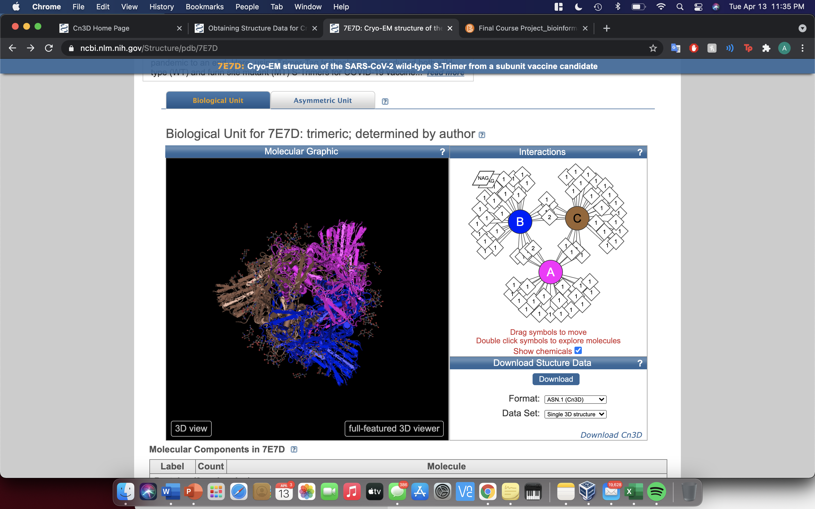

Slide 10
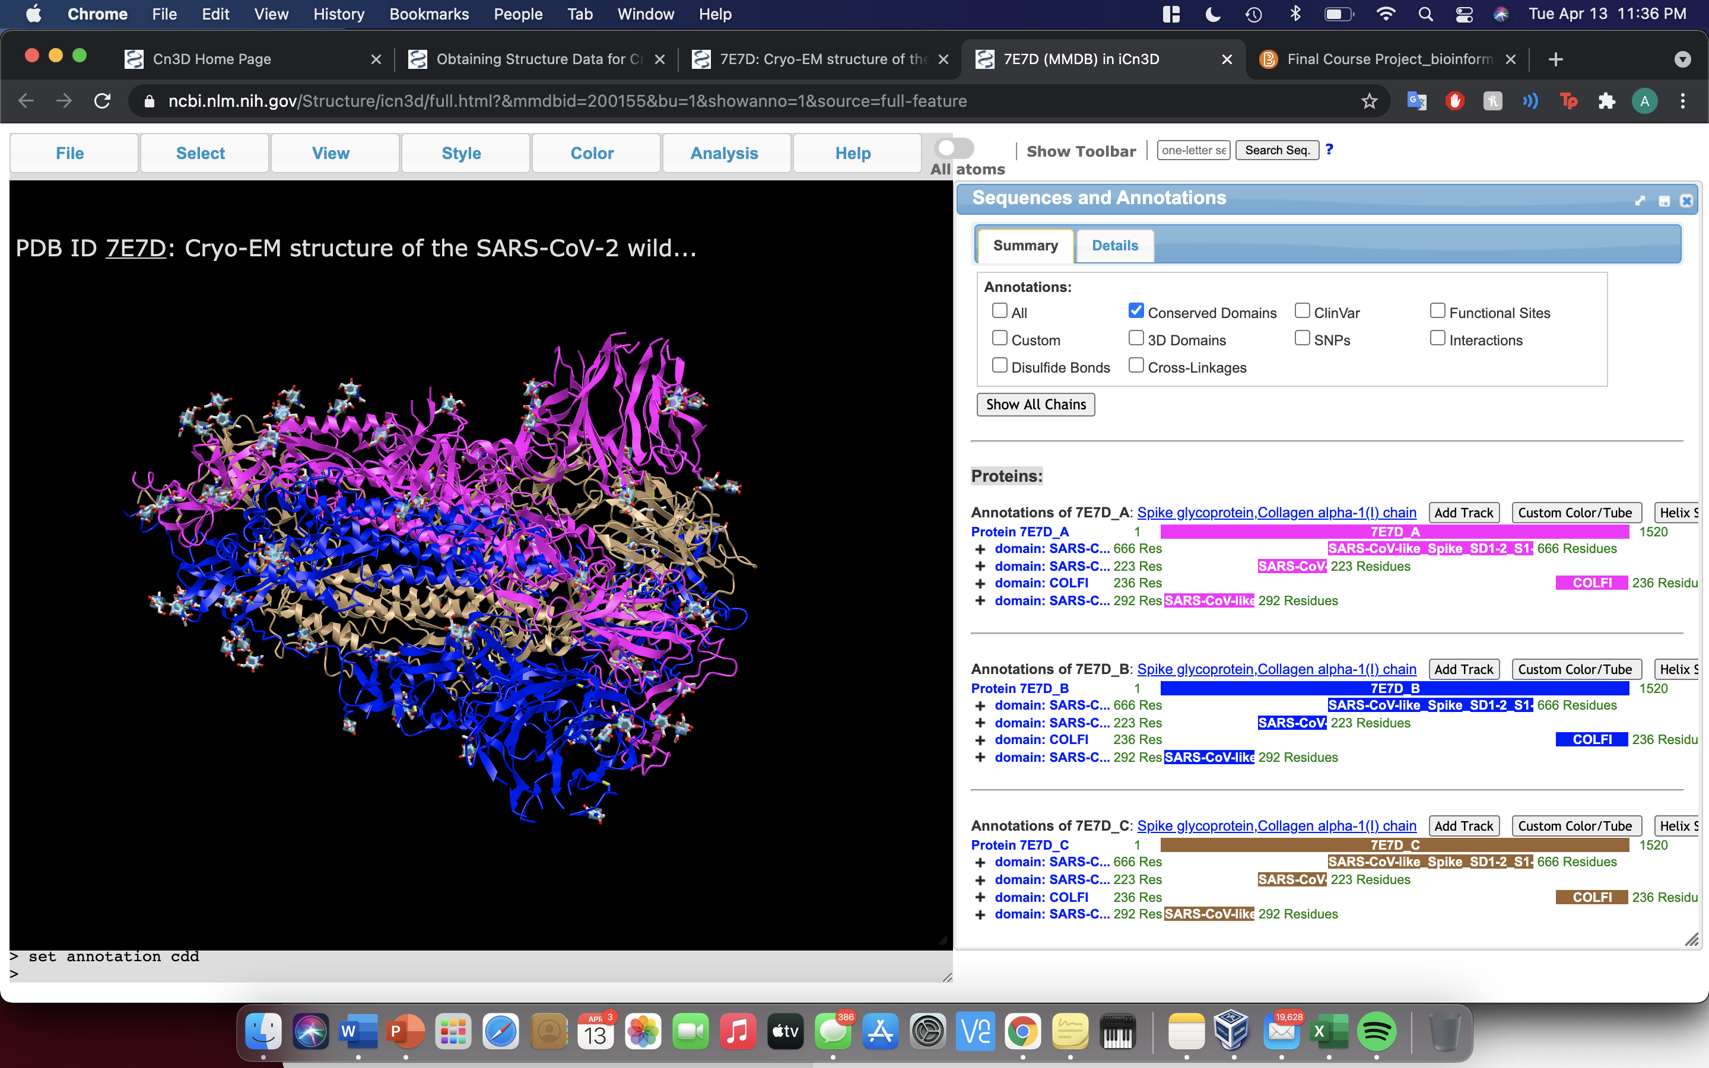

Slide 11
Method 2: BLAST Search
Step 1: Navigate to NCBI’s BLAST homepage
Step 2: Prepare a “blastp” (protein to protein) and select the Protein Database (pdb) in the Database menu
Step 3: BLAST!
Step 4: Select highest E-value hit
Step 5: Select “Structure-3D structure displays”
Notes:
Using O00633 for this example (Human PTEN)

Slide 12
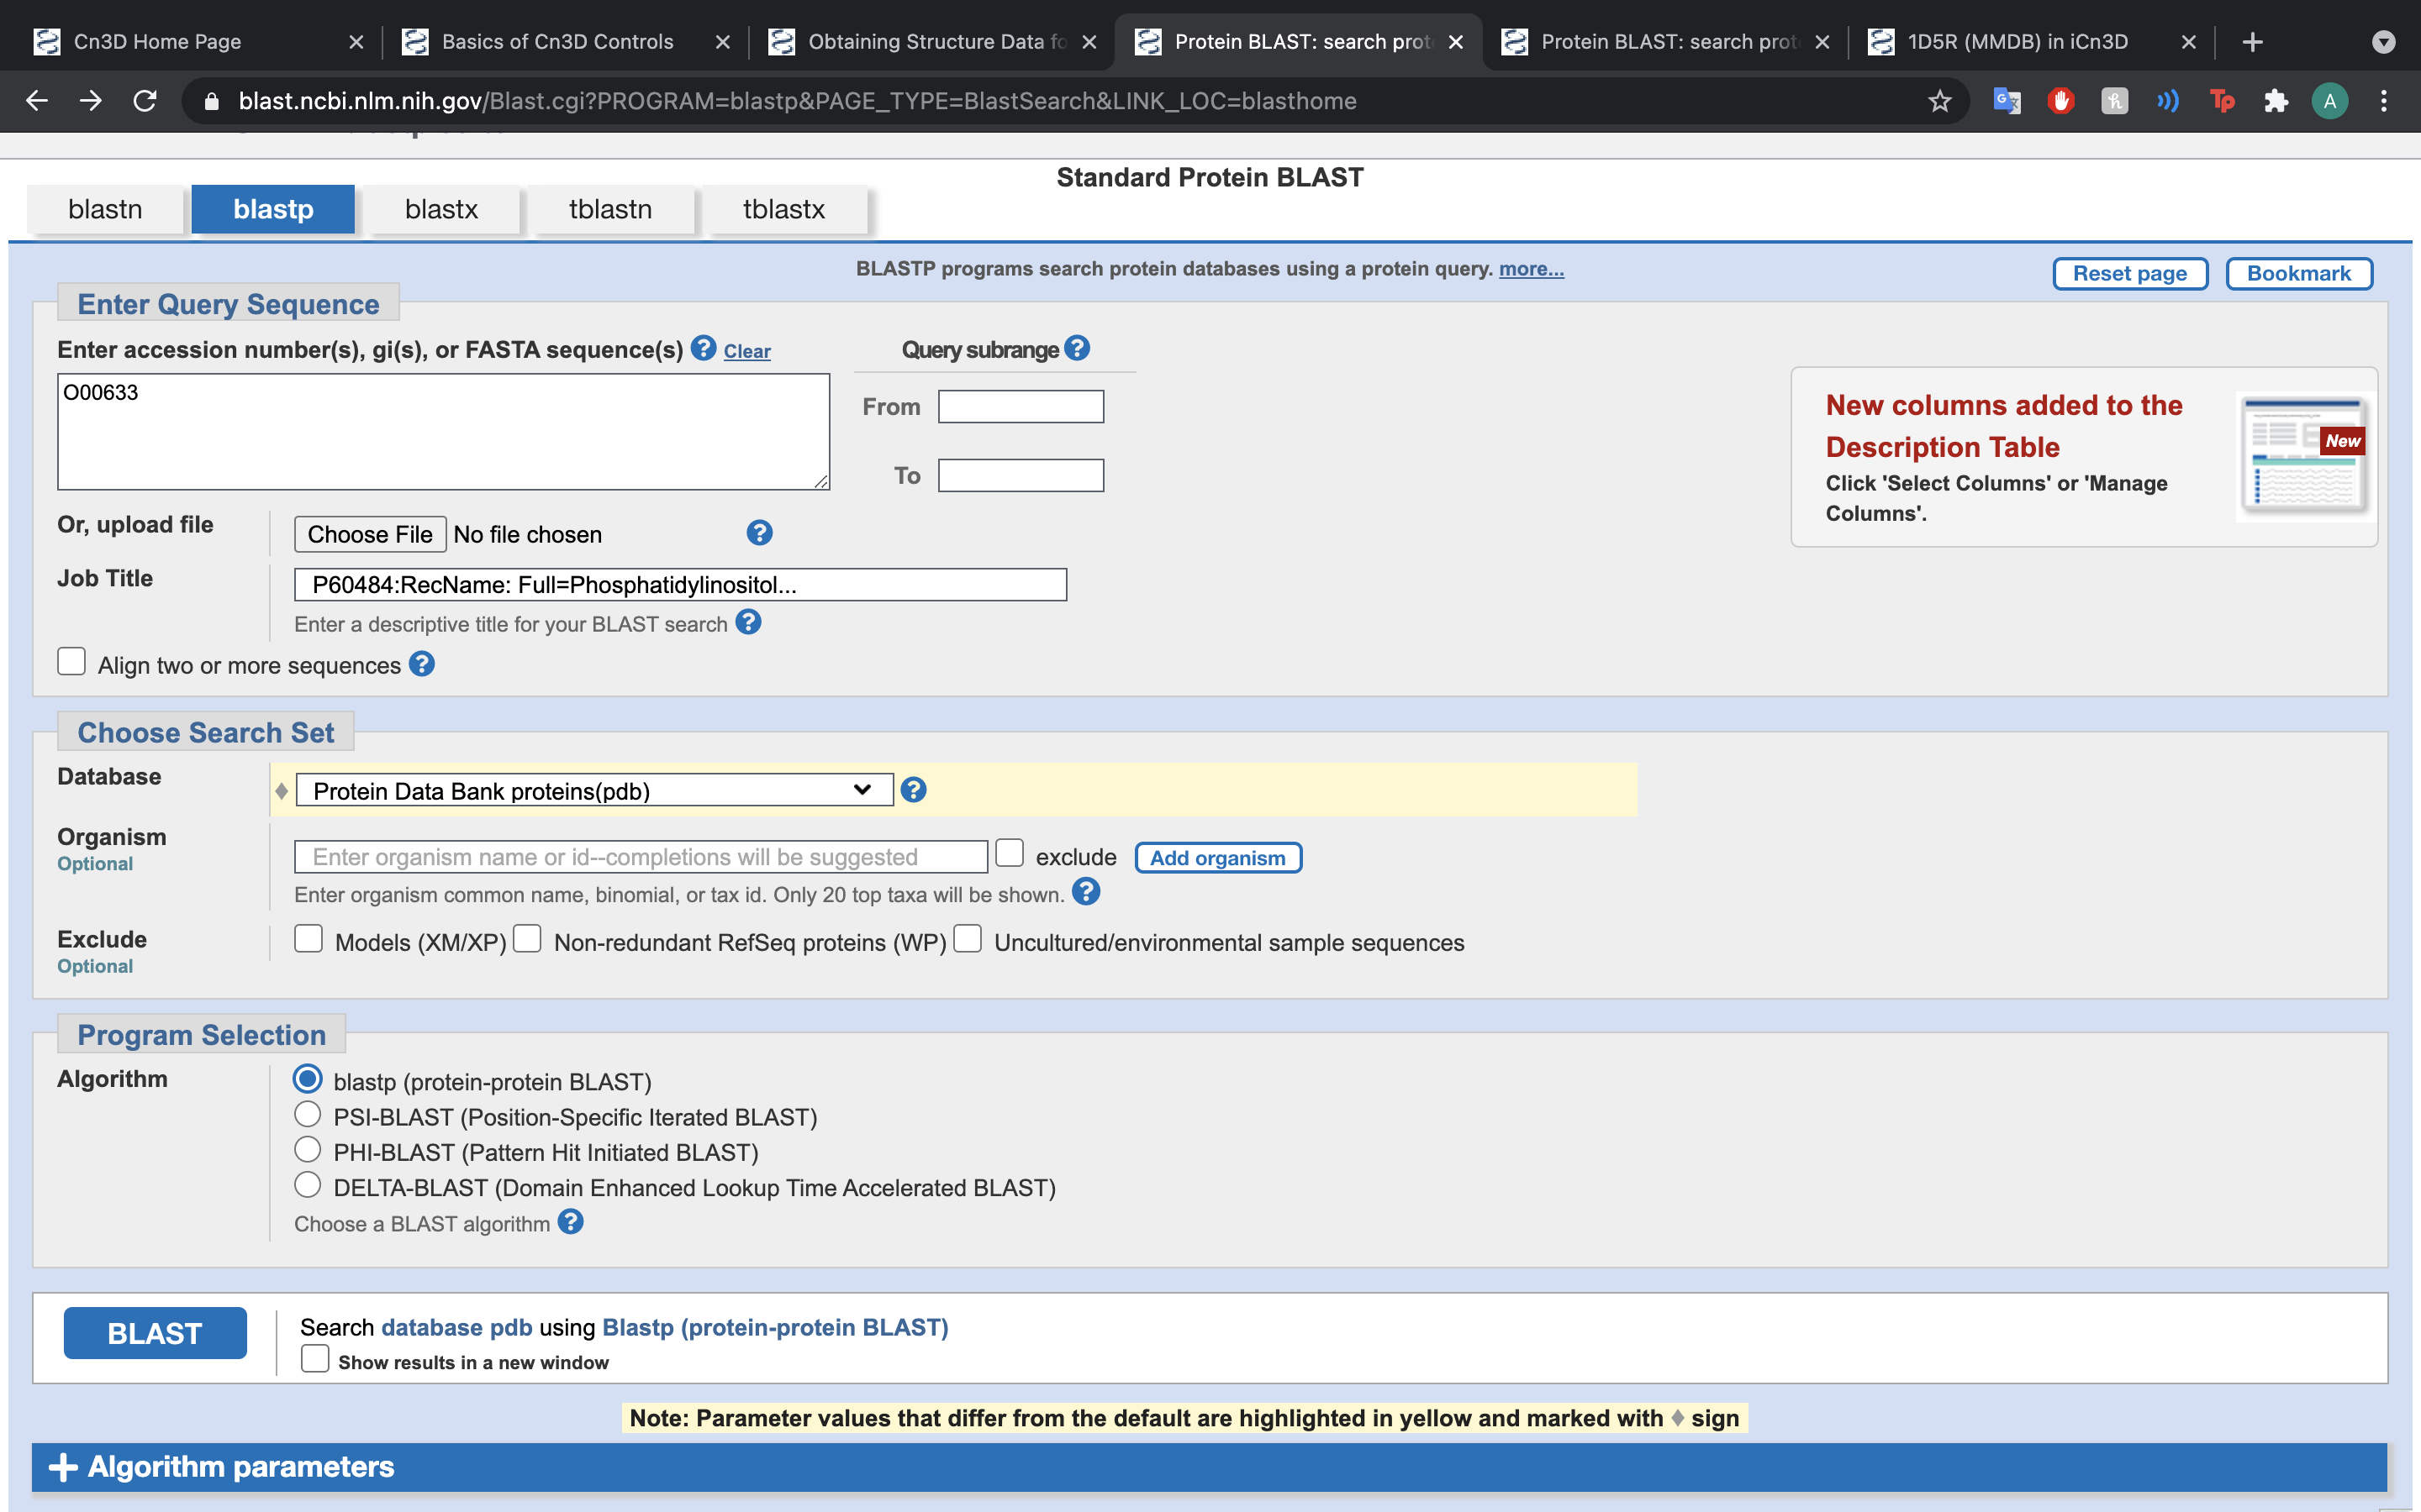

Slide 13
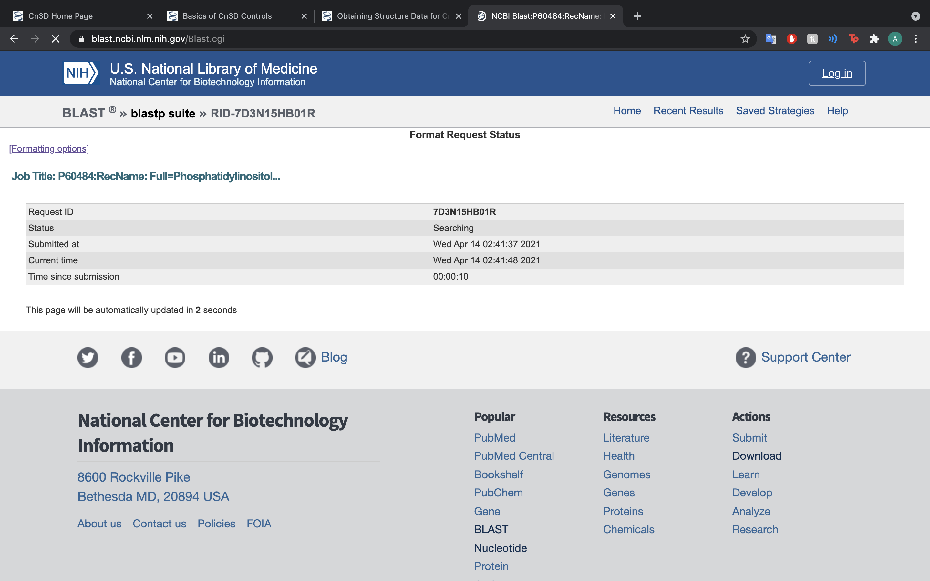

Slide 14
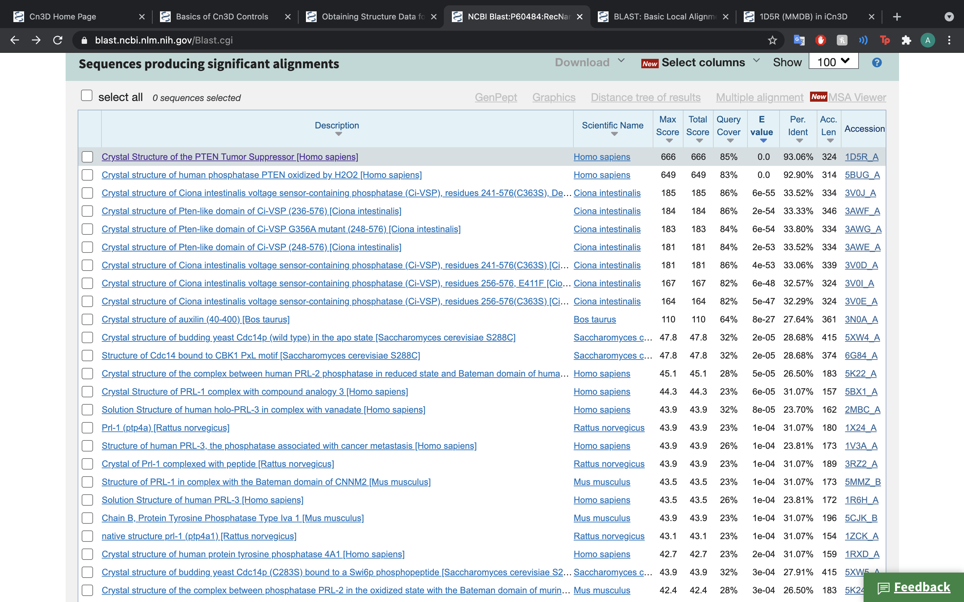

Slide 15
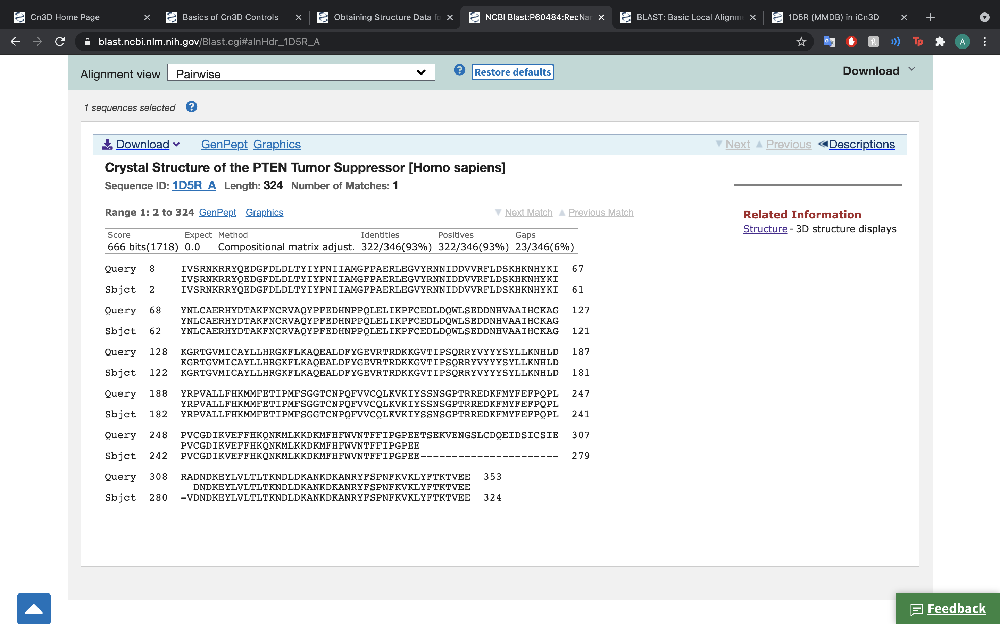

Slide 16
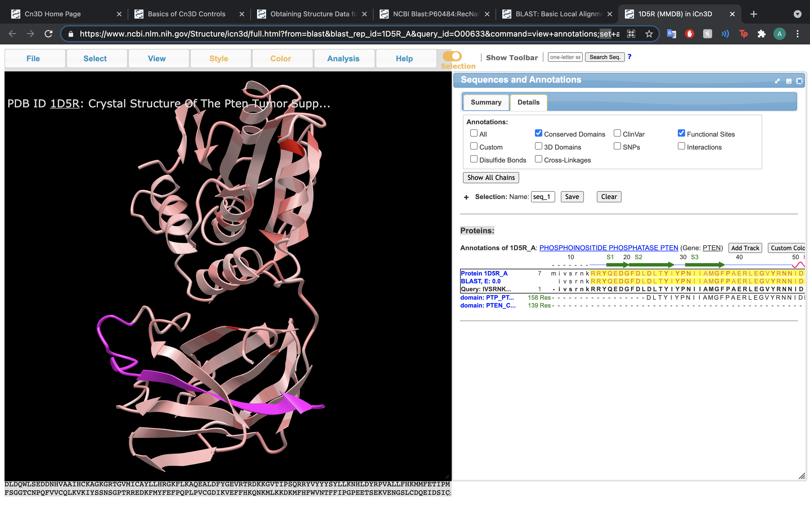

Slide 17
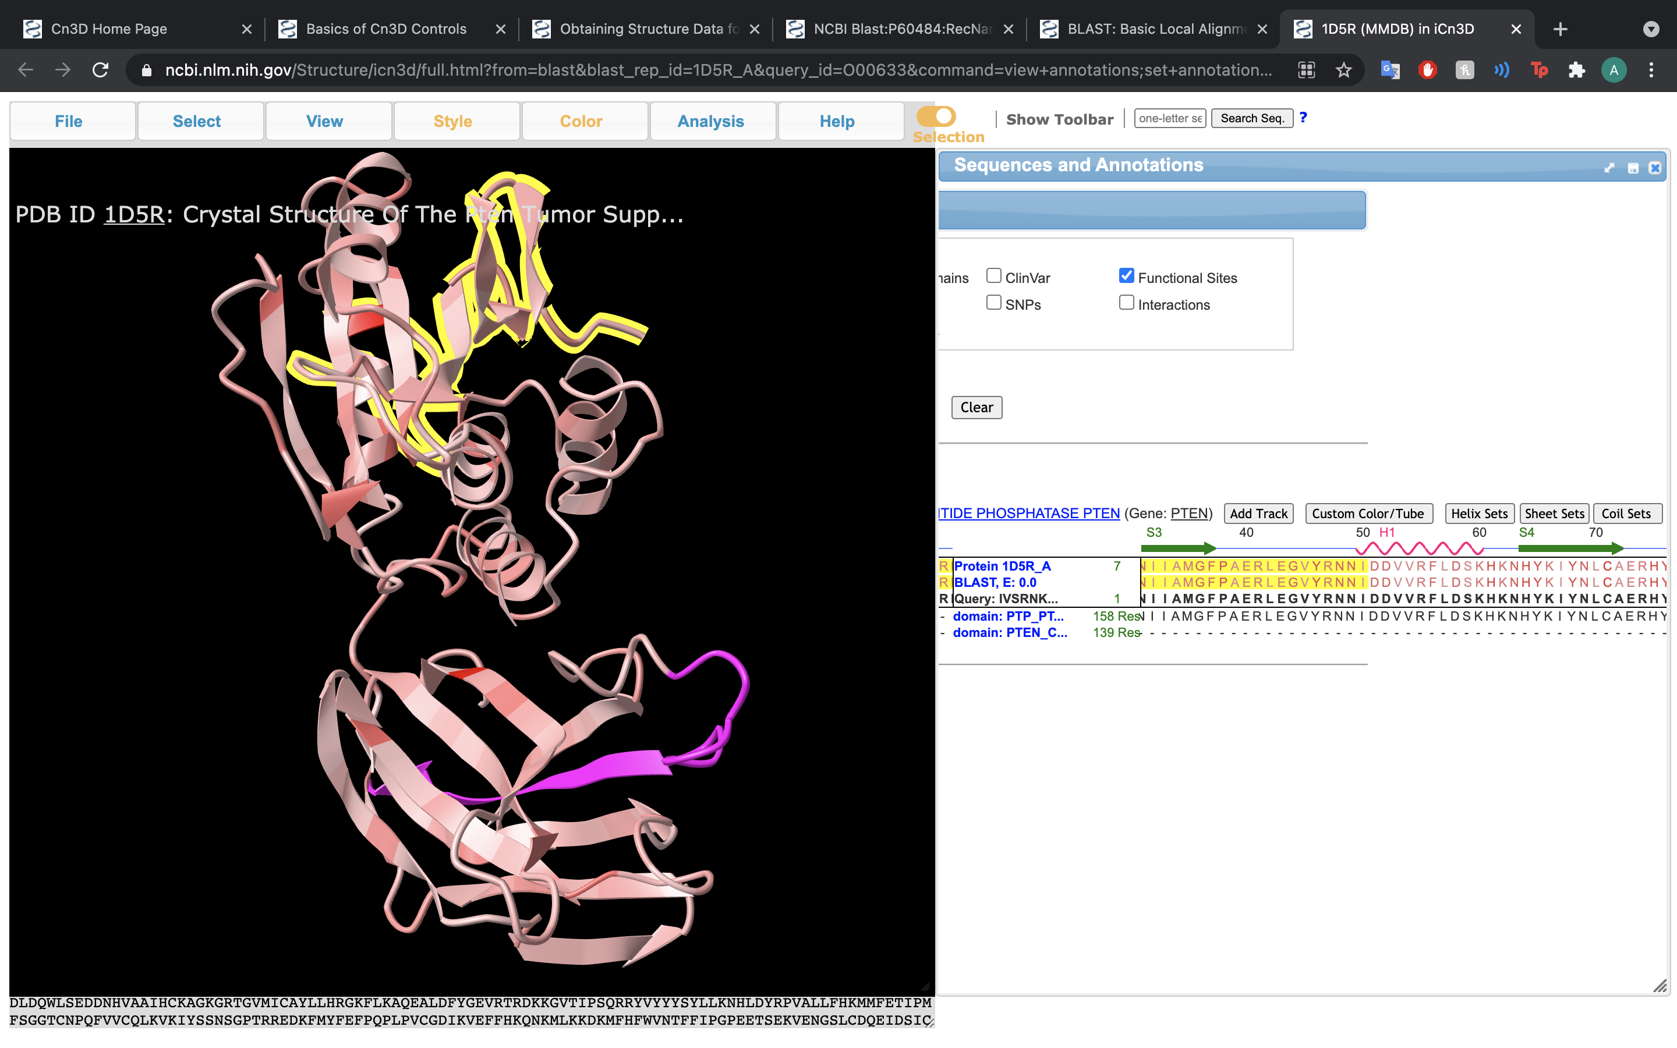

Slide 18
Cn3D Tools
STRUCTURE
Output to various file types
STYLE
Affect shape and color of protein and different parts of protein
SEQUENCE VIEWER
View the sequence of the protein corresponding with the part of the 3D structure

Slide 19
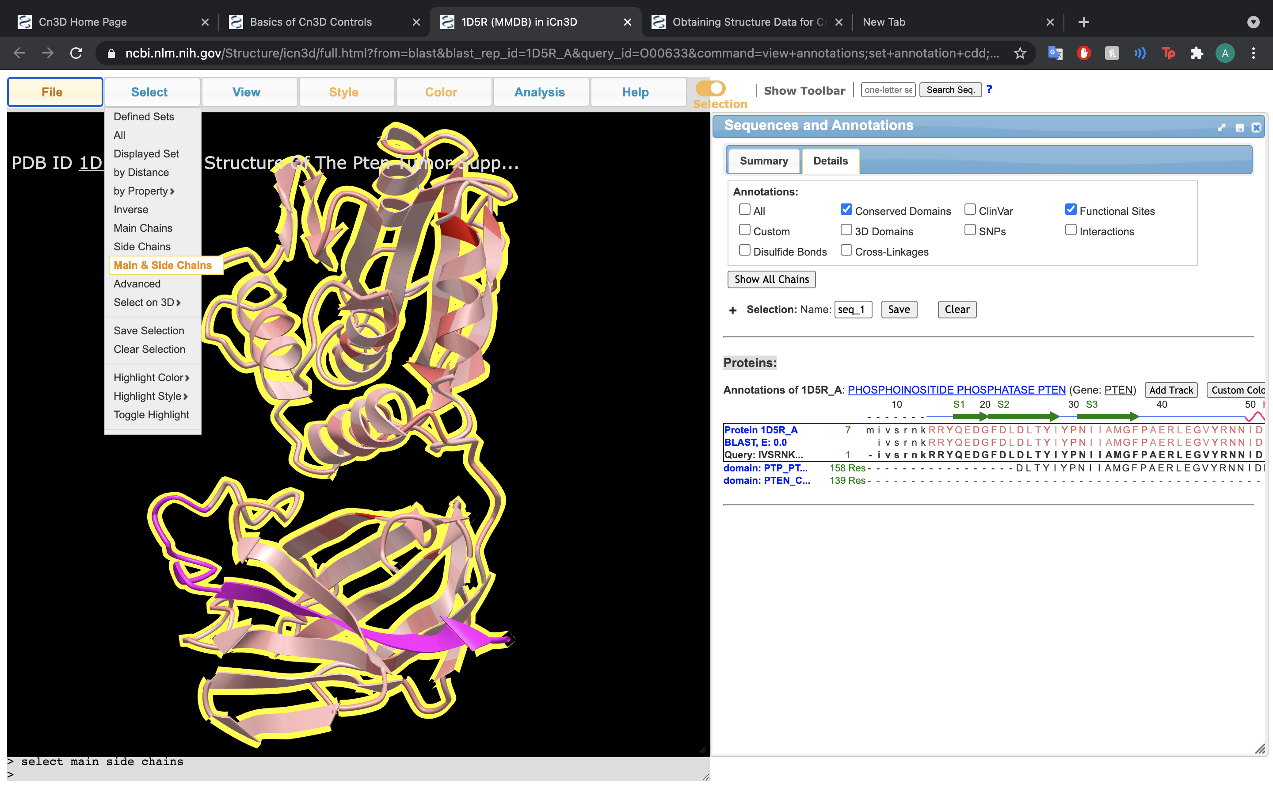

Slide 20
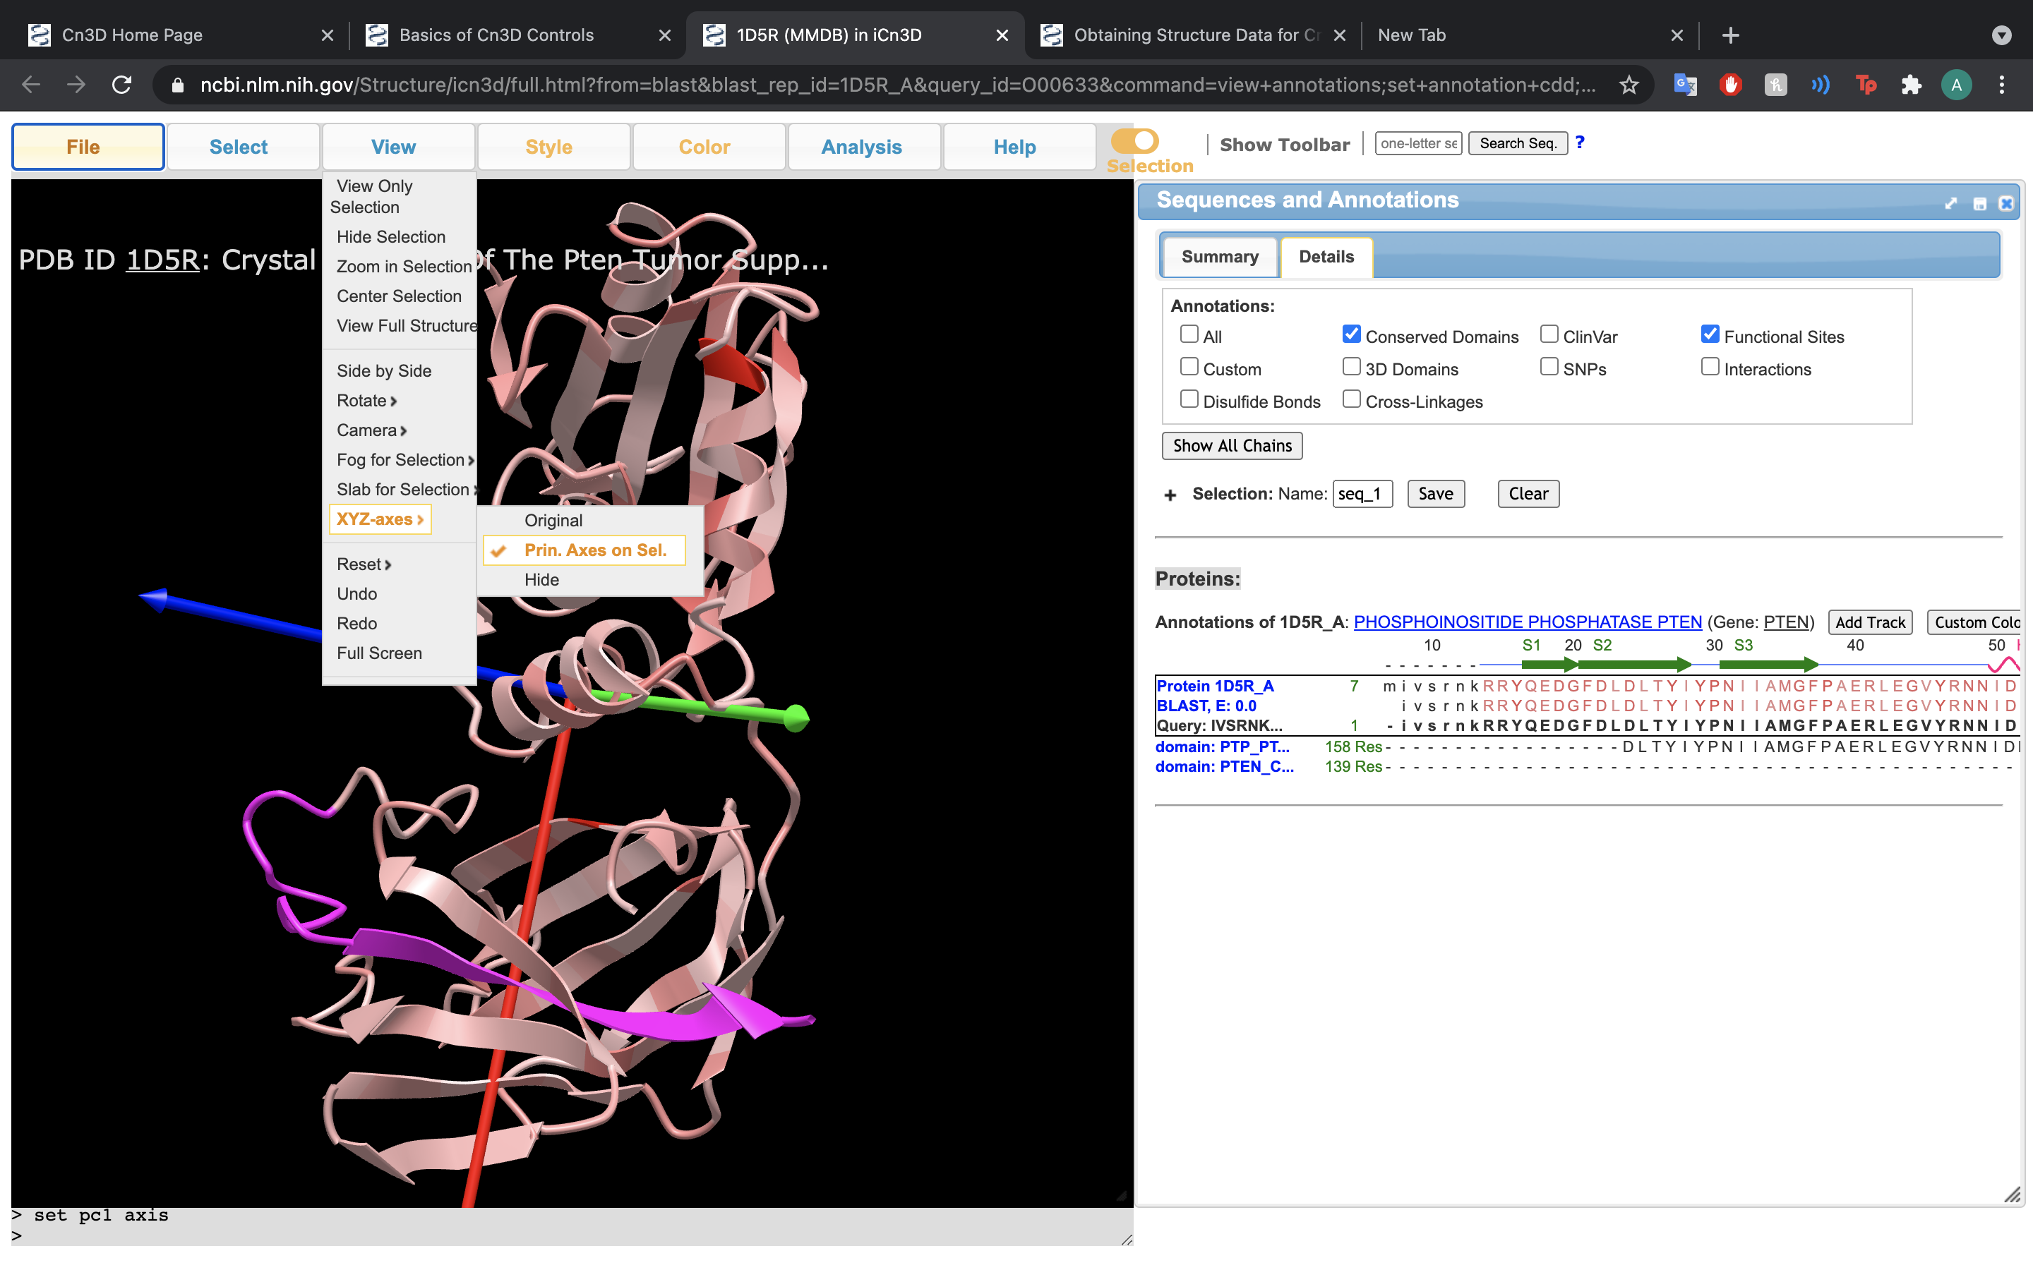

Slide 21
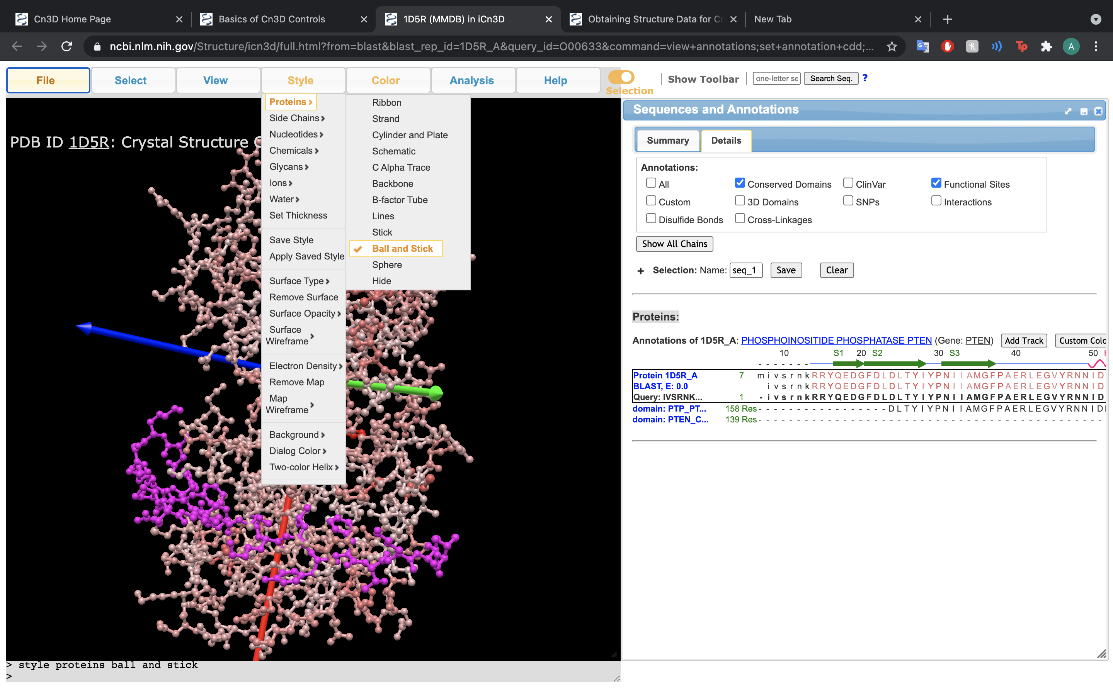

Slide 22
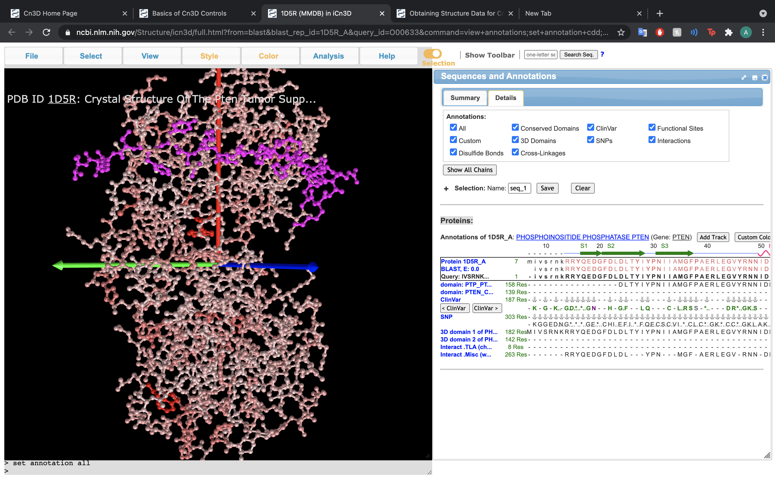

Slide 23
Incorporation with VAST
“Vector Alignment Search Tool” – a “3D-BLAST”
Finds structures similar to proteins
Step 1: Navigate to the VAST Homepage
Step 2: Search protein of interest
Step 3: Analyze MMDB summary page

Slide 24
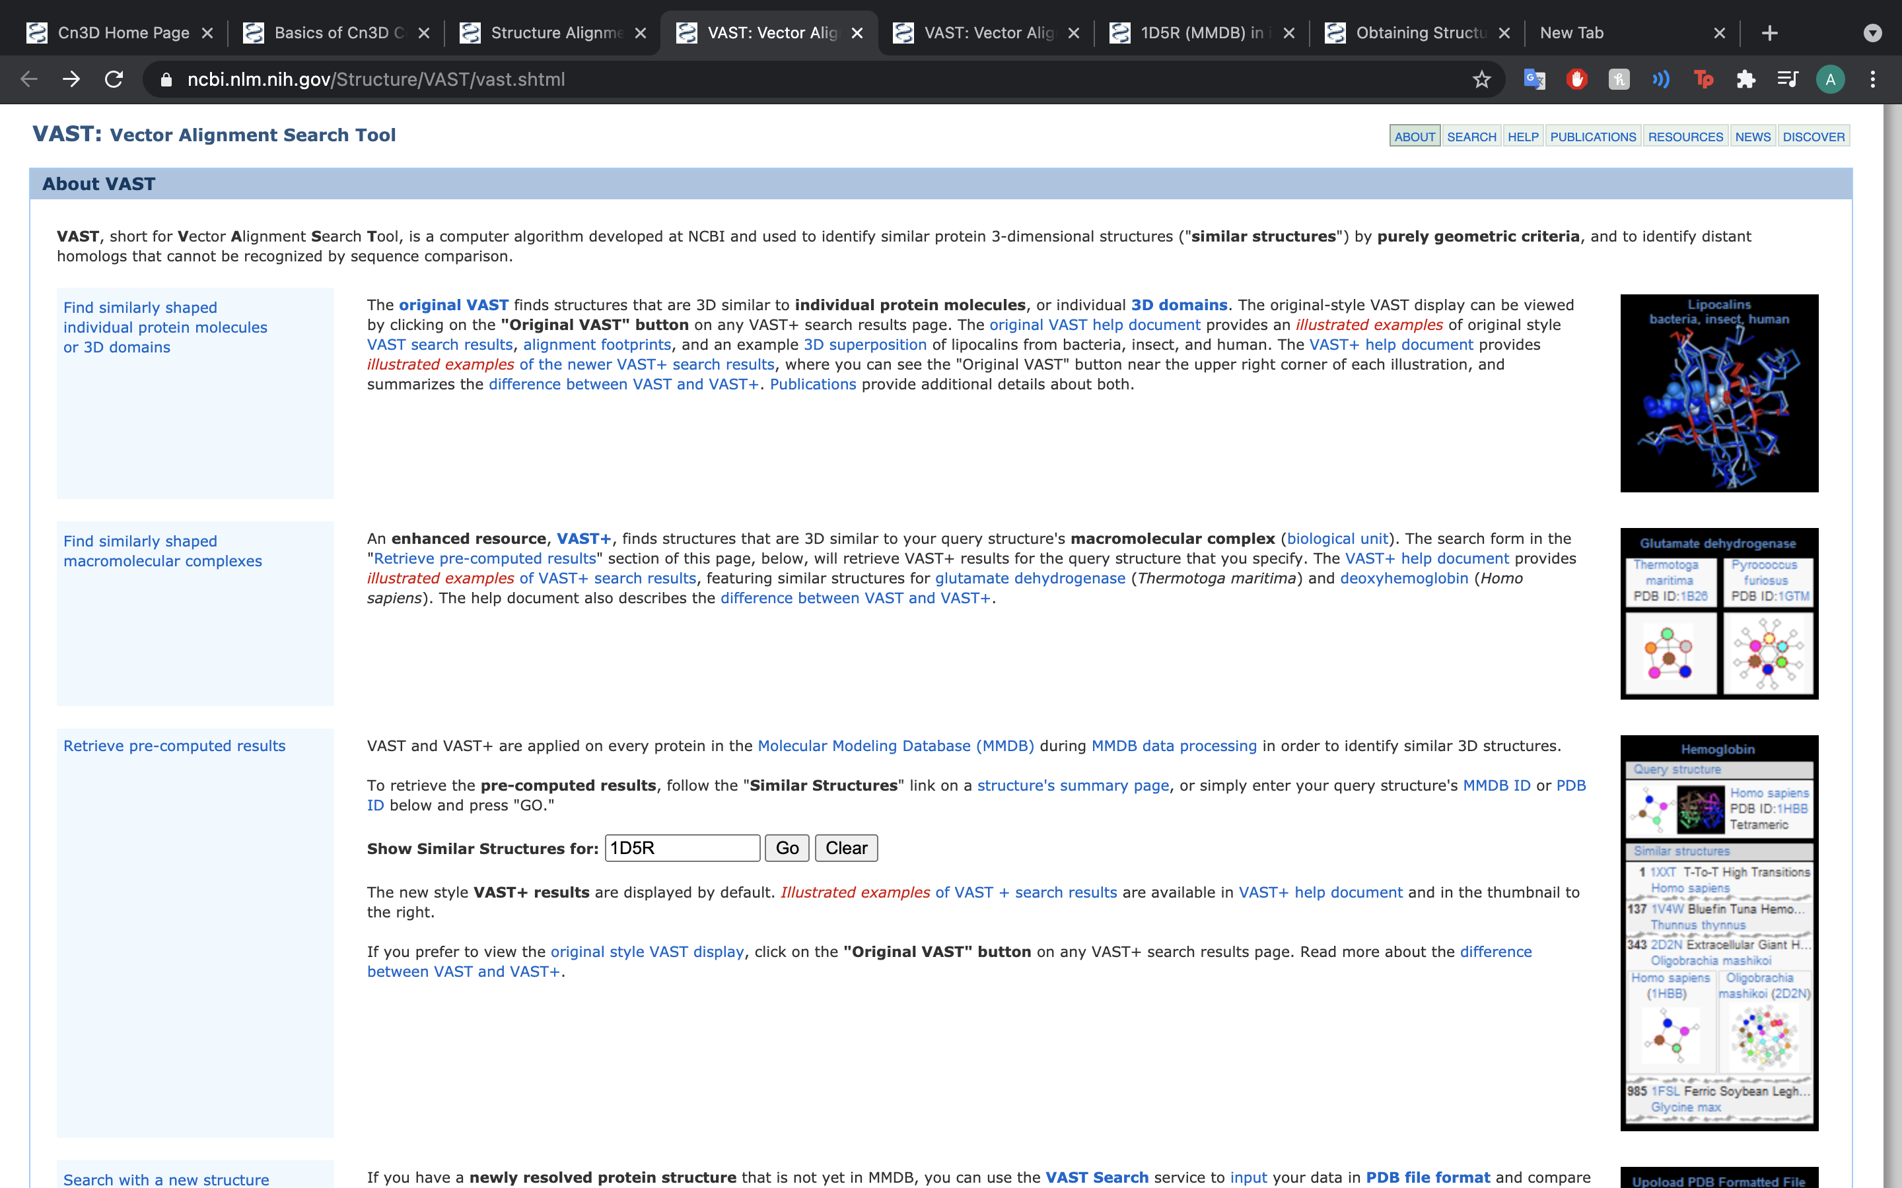

Slide 25
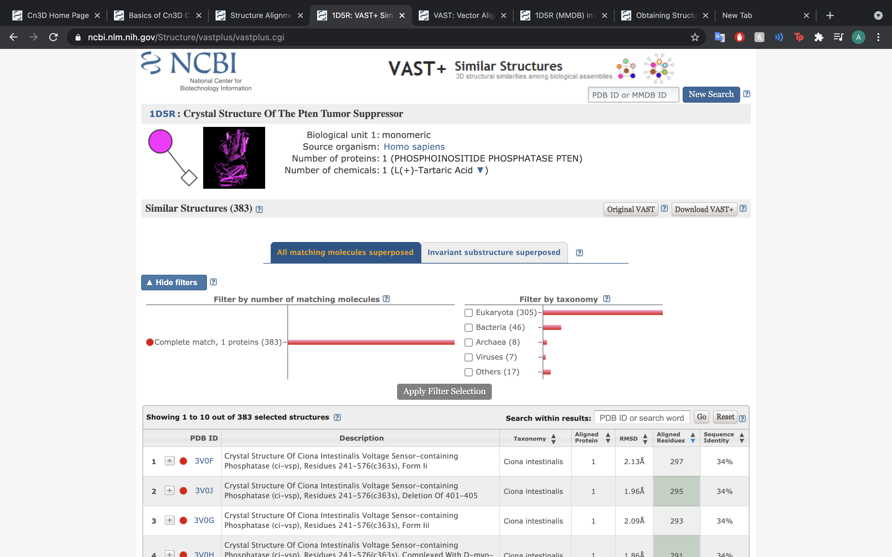

Slide 26
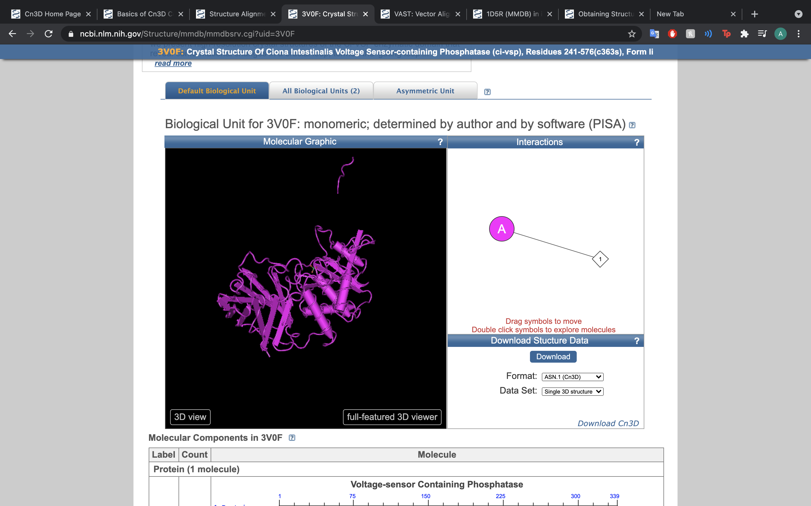

Slide 27
Shortcomings/Future Directions
Comparative real-time 3D structure-to-3D structure
Streamlined conversion metric for pdb to mmdb format

Slide 28
References:
Di Cristofano A, Pandolfi PP. The multiple roles of PTEN in tumor suppression. Cell 2000 Feb 18;100(4):387-90. Review. [PubMed PMID: 10693755]
Lee JO, Yang H, Georgescu MM, Di Cristofano A, Maehama T, Shi Y, Dixon JE, Pandolfi P, Pavletich NP. Crystal structure of the PTEN tumor suppressor: implications for its phosphoinositide phosphatase activity and membrane association. Cell 1999 Oct 29;99(3):323-34. [PubMed PMID: 10555148]
Liaw D, Marsh DJ, Li J, Dahia PL, Wang SI, Zheng Z, Bose S, Call KM, Tsou HC, Peacocke M, Eng C, Parsons R. Germline mutations of the PTEN gene in Cowden disease, an inherited breast and thyroid cancer syndrome. Nat Genet. 1997 May;16(1):64-7. [PubMed PMID: 9140396]

